Slide 1

Basic Electrical and Engineering UNIT-III: D.C Machines
By
Dr. G. Ramesh

Slide 2
Unit – III : Syllabus
Principle of operation of D.C generators,
Types of D.C generators,
E.M.F equation,
Principle of operation of D.C motors,
Types of D.C motors,
Torque equation, Losses and efficiency calculation in D.C Generators and D.C motors.
Applications of shunt and series motors.

Slide 3
Principle of Operation of D.C generators
An electrical generator is a machine that converts mechanical energy into electrical energy.
All the generators work based upon the principle of dynamically induced e.m.f.
This principle is nothing but the Faraday’s law of electromagnetic induction.
Whenever a conductor cuts magnetic flux, dynamically induced emf is produced in it according to Faraday's law of electromagnetic induction.
The change in flux associated with the conductor can exist only when there exists a relative motion between a conductor and the flux.

Slide 4
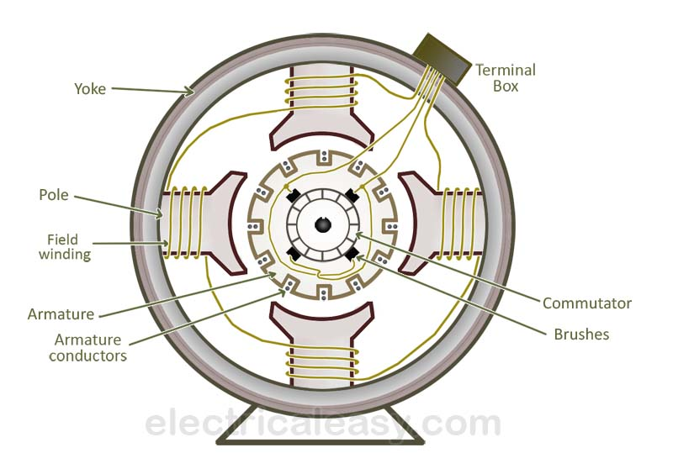
The below figure shows constructional details of a simple 4-pole DC machine. A DC machine consists of two basic parts; stator and rotor.

Slide 5
Basic constructional parts of DC machines are described below.
Yoke: The outer frame of a dc machine is called as yoke. It is made up of cast iron or steel. It not only provides mechanical strength to the whole assembly but also carries the magnetic flux produced by the field winding.
Poles and pole shoes: Poles are joined to the yoke with the help of bolts or welding. They carry field winding and pole shoes are fastened to them. Pole shoes serve two purposes; (i) they support field coils and (ii) spread out the flux in air gap uniformly.
Field winding: Field coils are placed on each pole and are connected in series. They are wound in such a way that, when energized, they form alternate North and South poles.

Slide 6
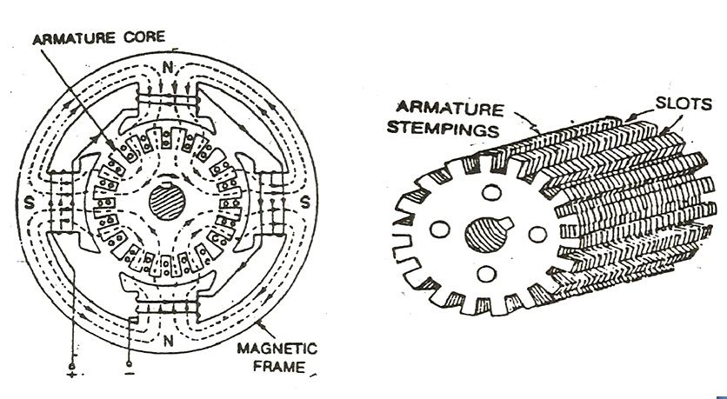
Armature core: Armature core is the rotor of a dc machine. It is cylindrical in shape with slots to carry armature winding.
Armature winding: It is usually a former wound copper coil which rests in armature slots. The armature conductors are insulated from each other and also from the armature core. Armature winding can be wound by one of the two methods; lap winding or wave winding.

Slide 7
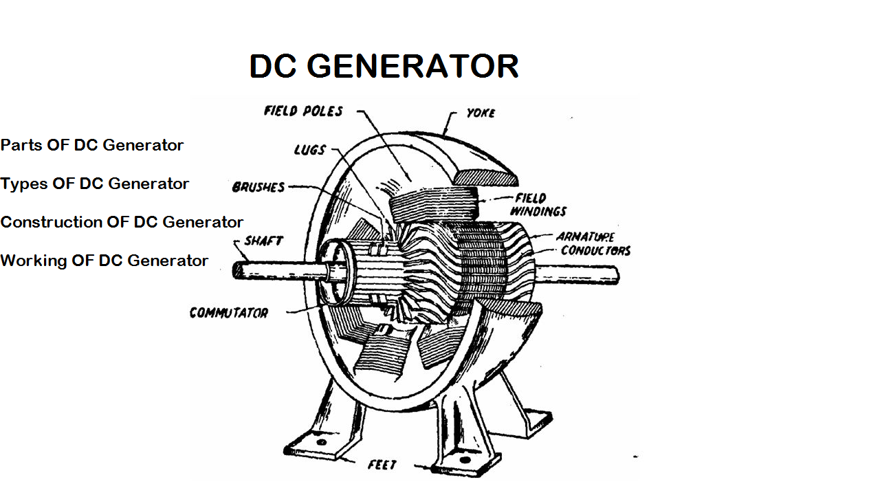
Commutator : Physical connection to the armature winding is made through a Commutator-brush arrangement. The function of a Commutator, in a dc generator, is to collect the current generated in armature conductors.

Slide 8
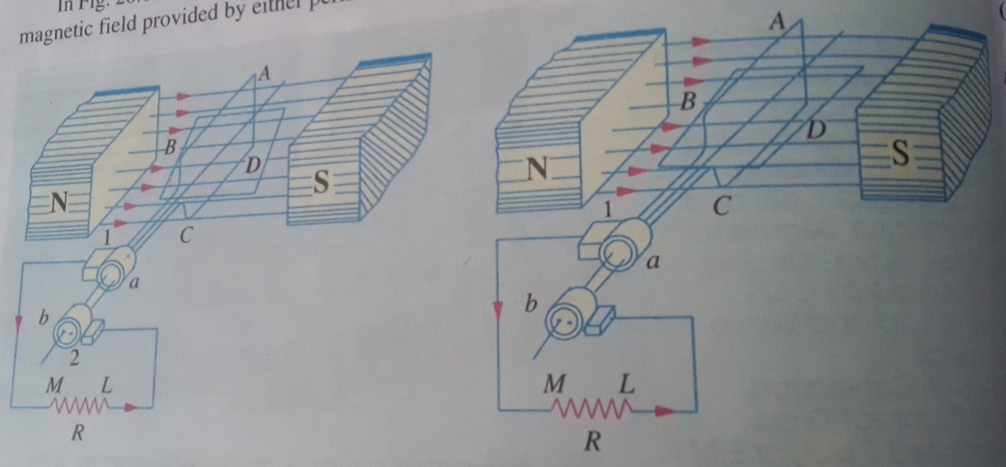
Operation of DC Generator: The below figures shows, a single-turn rectangular copper coil ABCD rotating about its own axis in a magnetic filed provided by either permanent magnet or electromagnets.
This emf causes a current to flow if a conductor circuit is closed. From above figure, a single turn rectangular copper coil ABCD rotating about its own axis in a magnetic field provided by either permanent magnet or electromagnets.

Slide 9
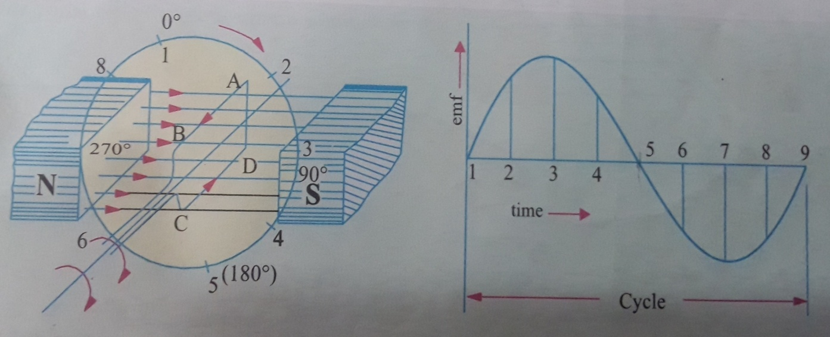
The two ends of the coil are joined to two slip-rings ‘a’ and ‘b’ which are insulated from each other and from the central shaft.
Two collecting brushes (carbon) press against the slip-rings, their function is to collect the current in the coil.
Assume the generator coil is rotating in clock-wise direction. As the coil assumes successive position in the field, the flux linked with it changes.

Slide 10
The emf induced in the coil is proportional to the rate of change of flux linkages .
The coil at position 1 (0 deg), flux linked with the coil is maximum but rate of change of flux linkages are minimum. Hence, there is no induced emf in the coil.
The coil position at 3 (90 deg), the flux linked with the coil is minimum but rate of change of flux is maximum. Hence, maximum emf is induced in the coil.
The coil position at 5 (180 deg), the induced emf is zero.
The direction of this induced emf can be found by Flemings right hand rule (generator) and Flemings lift hand rule in motors.

Slide 11
The direction of current flowing through load resistor from M to L during the first half revolution (ABMLCD).
In next half revolution i.e. from 180 to 360 deg, the current flowing from D to C and B to A, the current path is DCLMBA which is just reverse of the previous direction of flow.
Therefore , we find the current in coil is alternative (ac), the two half cycle may be called positive and negative half cycles.
For making the flow of current unidirectional in the external circuit, the slip rings are replaced by slit-ring, is shown in figure below.
The split-rings are made out of a conducting cylinder which is cut into two haves or segments insulated from each other by a thin sheet of mica. The coil ends are joined to these segments on which rest the carbon brushes.

Slide 12
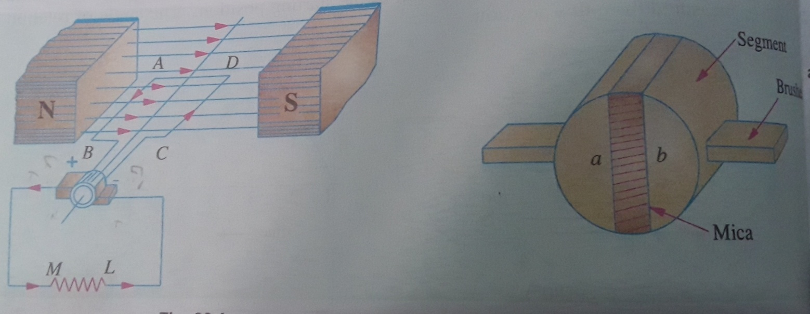
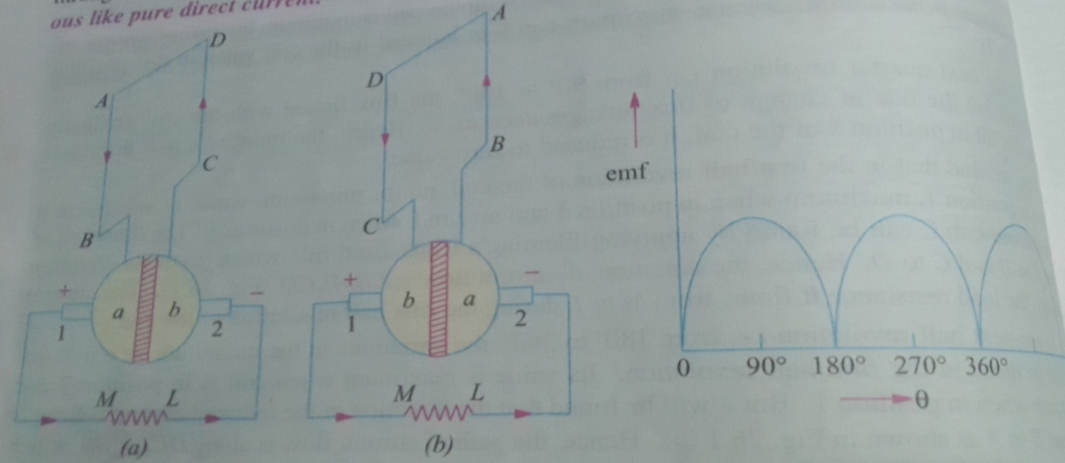

Slide 13
In first half cycle the current flows along ABMLCD i.e. the brush no.1 in contact with segment ‘a’ acts as the positive end of the supply and ‘b’ as the negative end.
In next half revolution, the direction of the induced current in the coil has reversed, but at the same time, the position of segments ‘a’ and ‘b’ have also reversed.
Hence, the current flows along ABMLCD. The waveform of the current through the external circuit is unidirectional but not continuous like pure direct current (DC).
The above observation, the current induced in the coil is alternative but due to rectifying action of the split-rings ( also called commentator) that is becomes unidirectional in the external circuit.

Slide 14
EMF Equations of a Generator
As the armature rotates, a voltage is generated in its coils. In the case of a generator, the emf of rotation is called the Generated emf (Eg).
Let,
P – Number of poles of the machine
ϕ – Flux per pole in Weber
Z – Total number of armature conductors
N – Speed of armature in revolution per minute (r.p.m)
A – Number of parallel paths in the armature winding
Eg- e.m.f indued in any one of the parallel paths

Slide 15
In one revolution of the armature, the flux cut by one conductor is given as
the flux cut by one conductor = weber (1)
Time taken to complete one revolution is (2)
Therefore, the average induced e.m.f in one conductor will be
(3)
The number of conductors connected in series in each parallel path = Z/A, the average induced e.m.f across each parallel path or the armature terminals is given by the equation shown below.

Slide 16
(4)
Note: Simplex wave winding no of parallel paths A=2 and Simplex Lap winding no of parallel paths A= no. of poles (P)
Problem 1: A 4 pole, lap wound, d.c. generator has a useful flux of 0.07 Wb per pole. Calculate the generated e.m.f. when it is rotated at a speed of 900 r.p.m. with the help of prime mover. Armature consists of 440 number of conductors. Also calculate the generated e.m.f. if lap wound armature is replaced by wave wound armature.

Slide 17
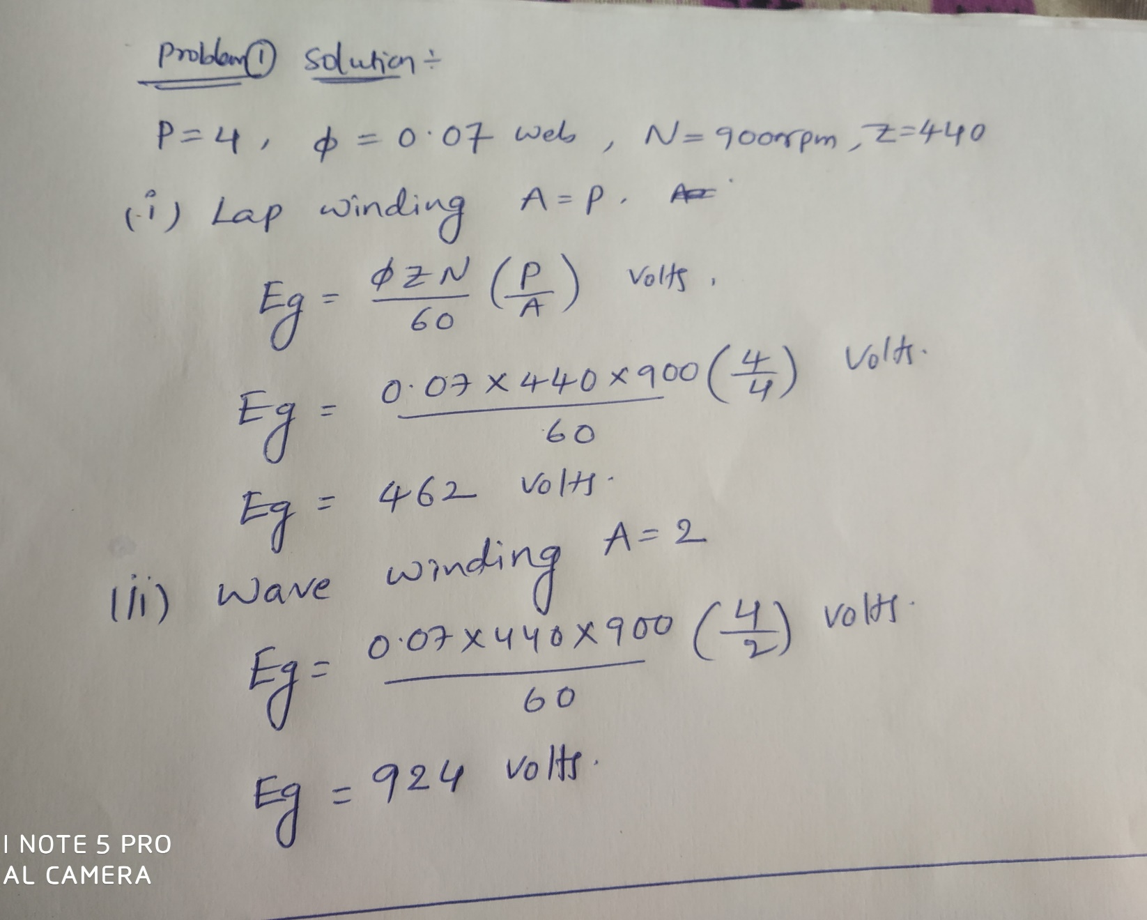

Slide 18
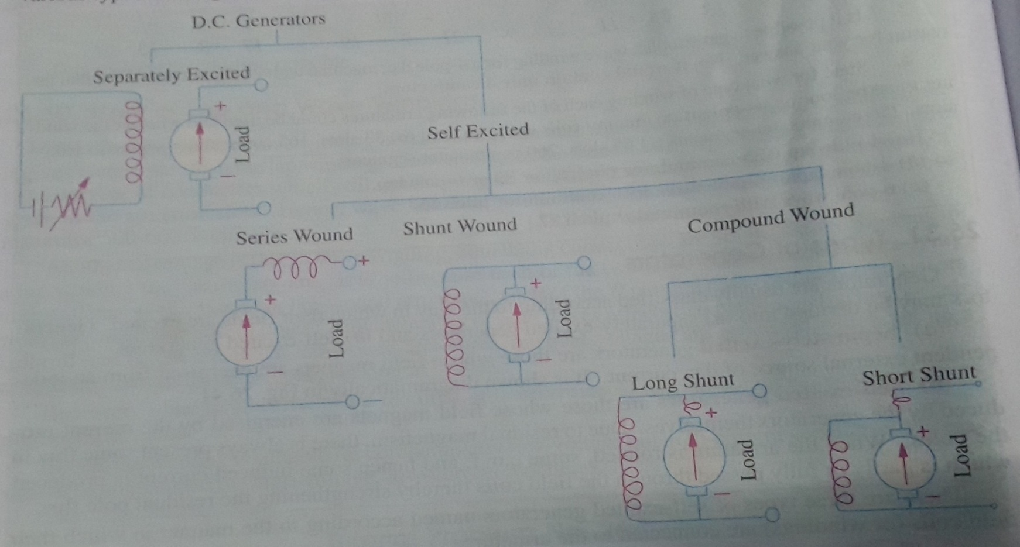
Types of DC Generators
Generators are usually classified according to the way in which their fields are excited.

Slide 19
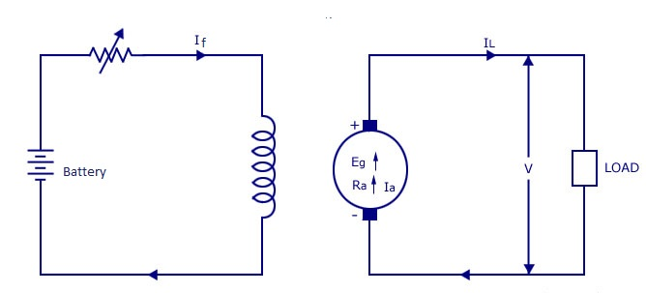
1. Separately excited DC generator: Field coils excited by some external source
I_{a} = Armature current, I_{L} = Load current, V = Terminal voltage, R_{a} = Armature resistance,
Let I_{a}=I_{L} = I current in series
The voltage across the load (V)=E_{g} –I. R_{a}
The power generated (P_{g})=E_{g}.I
The power delivered to external load (P_{L})=V.I

Slide 20
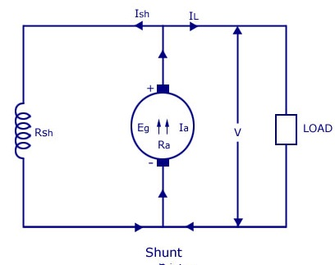
2. Shunt Generator: The field winding is connected in parallel with the armature winding so that the terminal voltage of the generator is applied across it.
The shunt field winding has many turns of fine wire having high resistance. Therefore, only a part of armature current flows through shunt field winding and the rest flows through the load.
I_{sh} = shunt field current
R_{sh} = Shunt field resistance

Slide 21
Where I_{a}=I_{sh} + I_{L} , Shunt field current is equal to
The voltage across the load (V)= E_{g} - I_{a}.R_{a}
The power generated (P_{g})=E_{g}. I_{a}
The power delivered to external load (P_{L})=V. I_{L}
Problem 2: A shunt generator delivers 450 A at 230V and the resistance of the shunt field and armature are 50 ohm and 0.03 ohm respectively. Calculate the generated e.m.f.

Slide 22
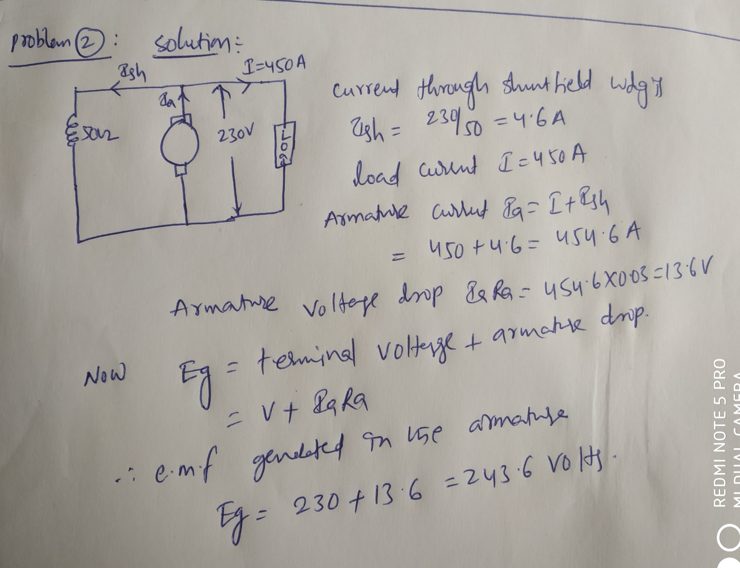

Slide 23
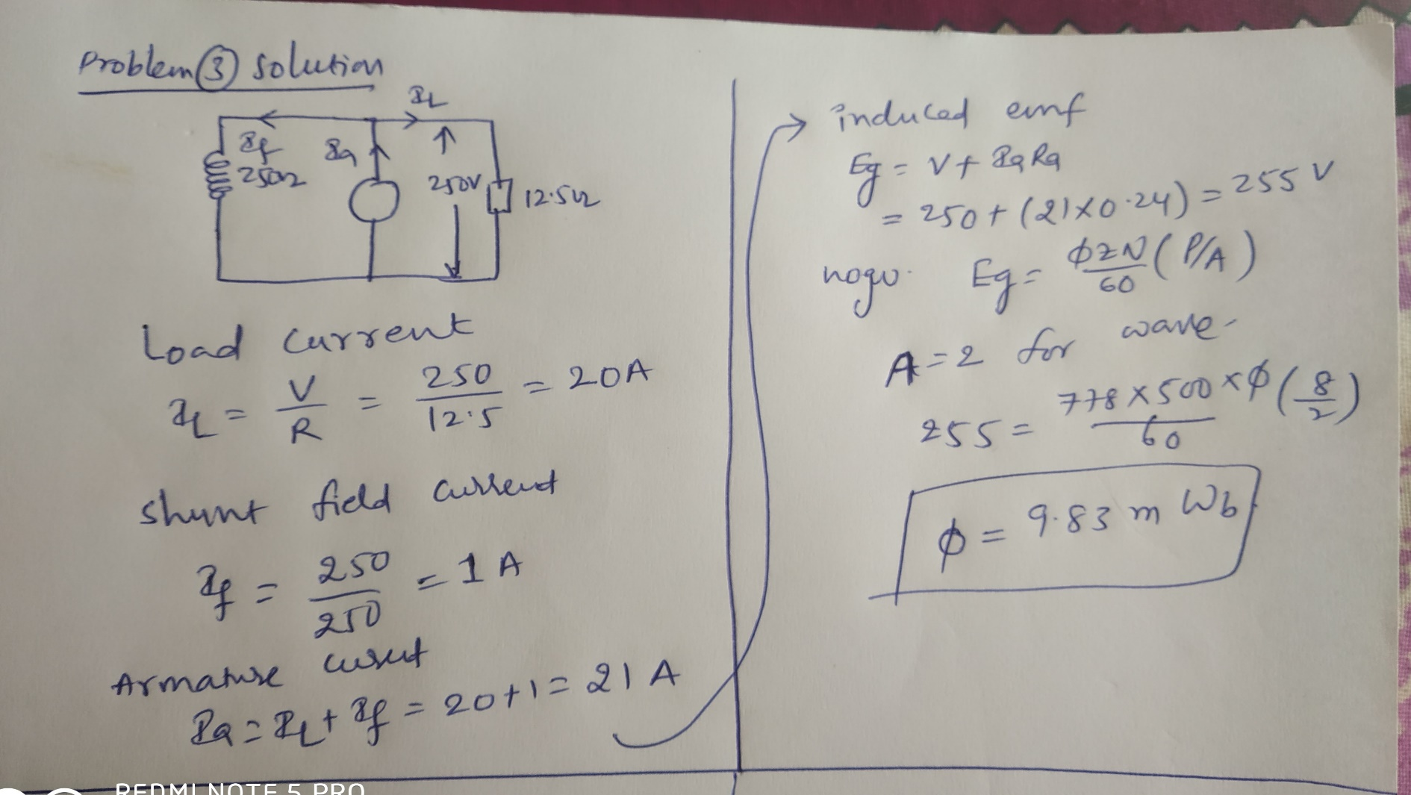
Problem 3: An 8-pole D.C shunt generator with 778 wave-connected armature conductors and running at 500 r.p.m . supplies a load of 12.5Ω resistance at terminal voltage of 250 V. The armature resistance is 0.24Ω and the field resistance is 250Ω. Find the armature current, the induced e.m.f and the flux per pole.?

Slide 24
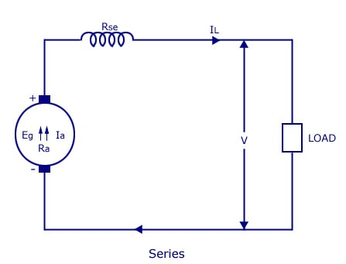
3. Series Generator: The armature winding is connected in series with the field winding so that the field current flows through the load as well as the field winding. The field winding is a low resistance, thick wire of few turns.
I_{se} = series field current,
R_{se} = Series field resistance,
Let I_{a}=I_{se} =I_{L}= I current in series , The voltage across the load (V)= E_{g} -I( R_{a} +R_{se} ), the power generated (P_{g})=E_{g}.I
The power delivered to external load (P_{L})=V.I

Slide 25
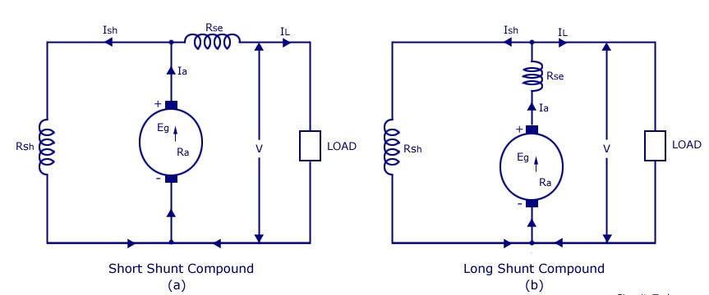
4. Compound Wound Generator: This type of DC generators may be of two types- short shunt and long-shunt compound-wound generators.
Short Shunt Compound Wound DC Generators are generators where only the shunt field winding is in parallel with the armature winding
Long Shunt Compound Wound DC Generator are generators where the shunt field winding is in parallel with both series field and armature winding.

Slide 26
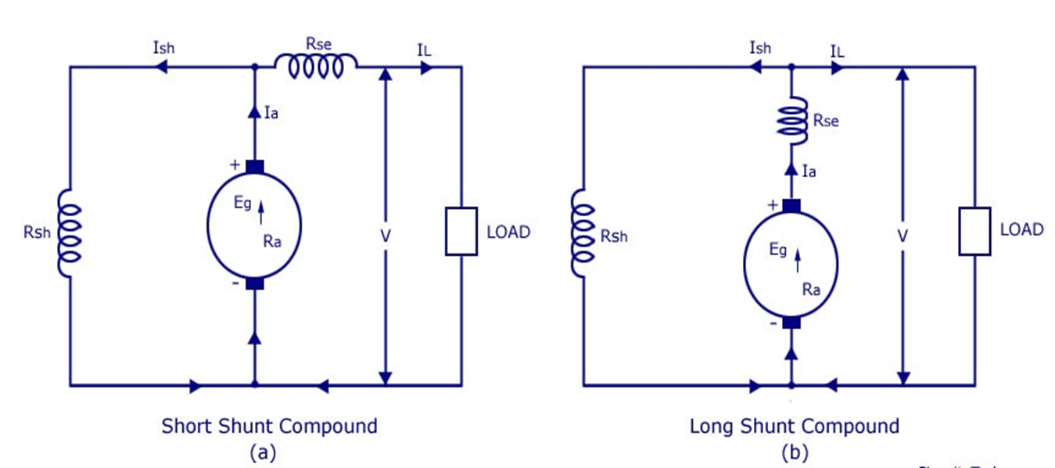
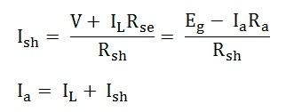
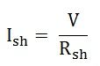
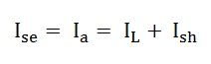
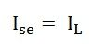
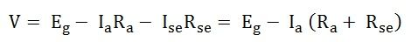
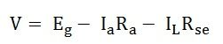
Shunt field current:
Series field current is given as:
Terminal Voltage:
Shunt field current:
Series field current is given as:
Terminal Voltage:

Slide 27
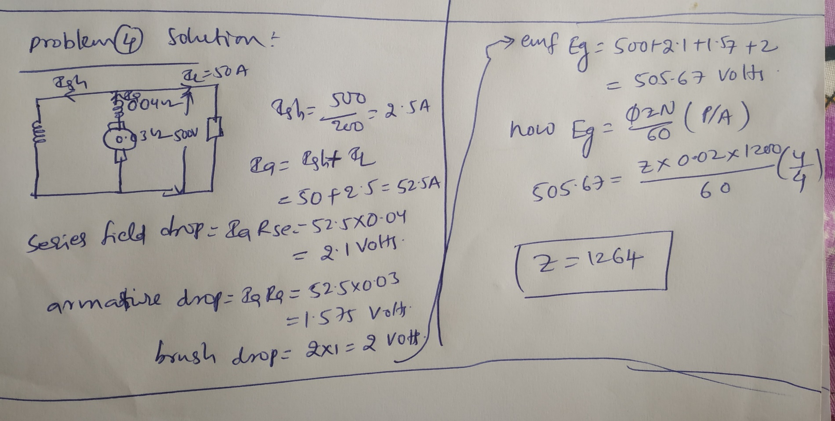
Problem4: A 4-pole, long-shunt lap-wound compound generator delivers a load current of (50 A) at (500 V). The armature resistance is (0.03 Ω), series field resistance is (0.04 Ω) and shunt field resistance is (200 Ω). The brush drop may be taken as (1V). Determine the e.m.f. generated. Calculate also the no. of conductors if the speed is (1200 r.p.m) and flux per poles (0.02 Wb). Neglect armature reaction.

Slide 28
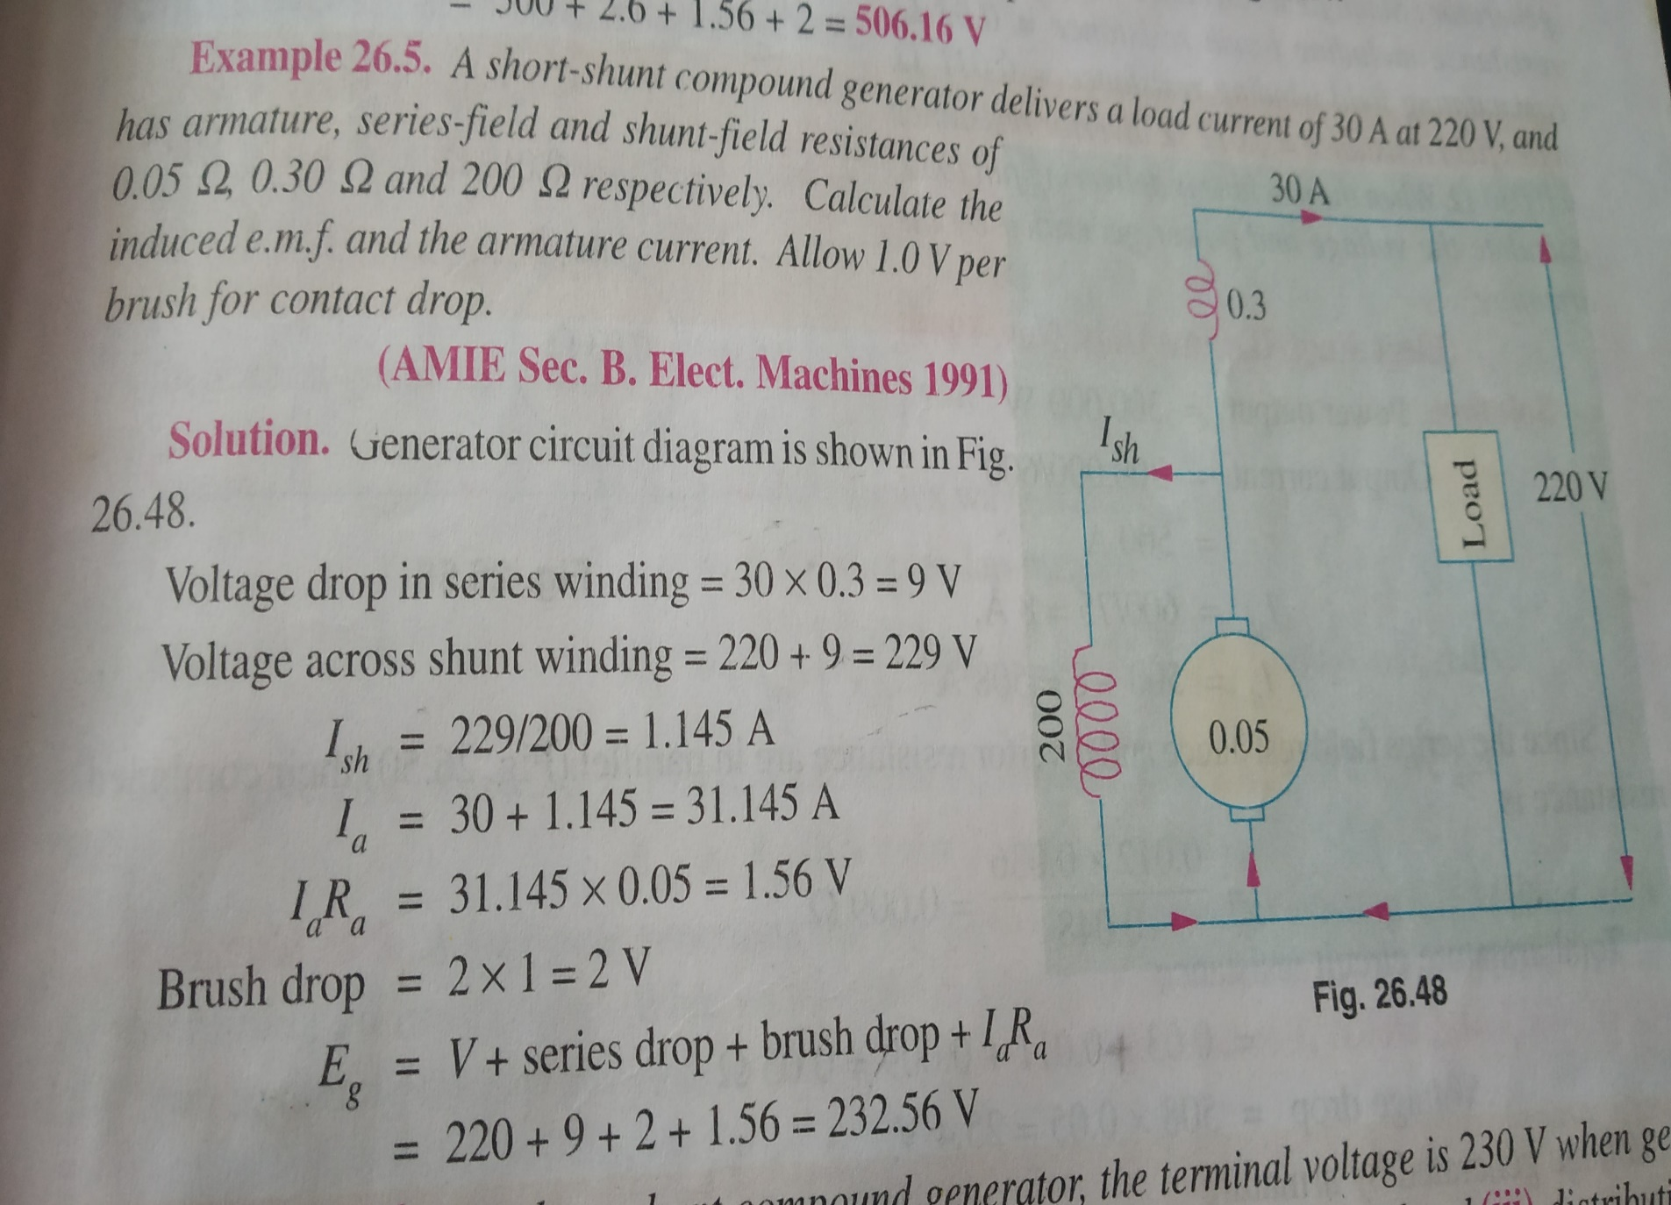

Slide 29
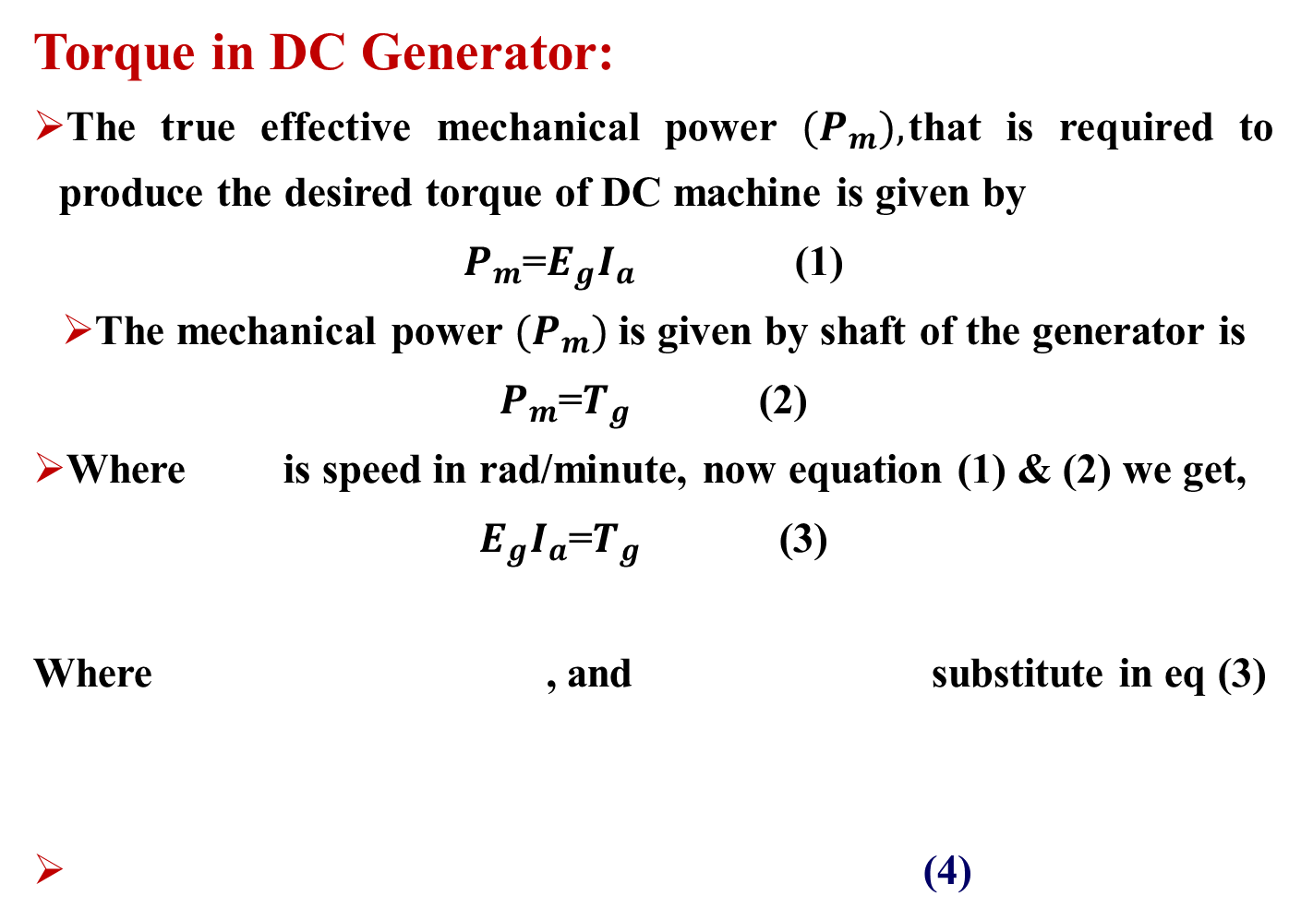
Torque in DC Generator:
The true effective mechanical power ${(P}_{m}),$that is required to produce the desired torque of DC machine is given by
$P_{m}$=$E_{g}I_{a}$ (1)
The mechanical power ${(P}_{m})$ is given by shaft of the generator is
$P_{m}$=$T_{g}$ (2)
Where is speed in rad/minute, now equation (1) & (2) we get,
$E_{g}I_{a}$=$T_{g}$ (3)
Where , and substitute in eq (3)
(4)

Slide 30
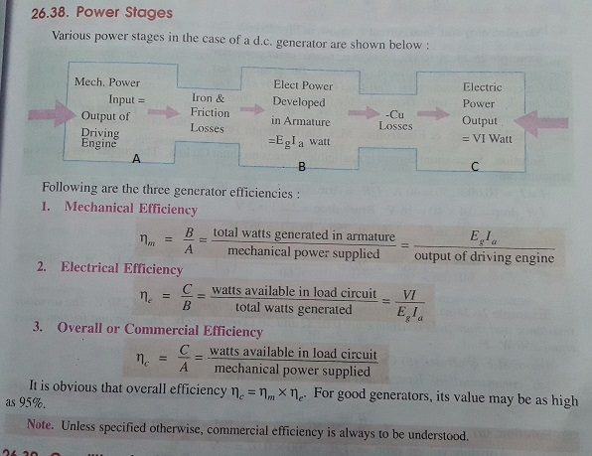
Power Stages in D.C Generator

Slide 31
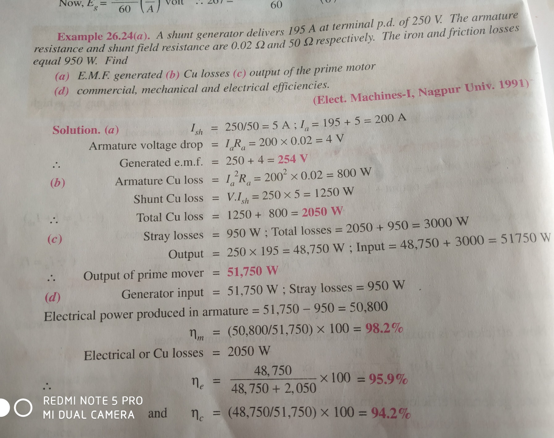

Slide 32
Principle of operation of D.C Motors
A motor is an electrical machine which converts electrical energy into mechanical energy.
The principle of working of a DC motor is that "whenever a current carrying conductor is placed in a magnetic field, it experiences a mechanical force".
The direction of this force is given by Fleming's left hand rule and it's magnitude is given by F = BIL. This force tending to rotate the armature.
Where, B = magnetic flux density, I = current and L = length of the conductor within the magnetic field.

Slide 33
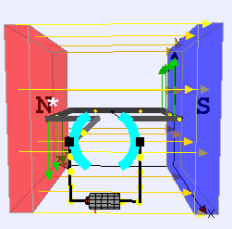
Construction ally, there are no basic difference between a DC generator and a DC motor. In fact, a same dc machine can be used interchangeably as a generator or motor.
DC motors also like generators shunt, series and compound generators.

Slide 34
Back EMF Equations of a Motor
When the armature of a DC motor rotates under the influence of the driving torque, the armature conductors move through the magnetic field and hence emf is induced in them as in a generator (Flemings right hand rule).
The induced emf acts in opposite direction to the applied voltage V (Lenz’s law) and is known as Back EMF or Counter EMF (Eb).
The back emf (Eb) is always less than the applied voltage V.

Slide 35
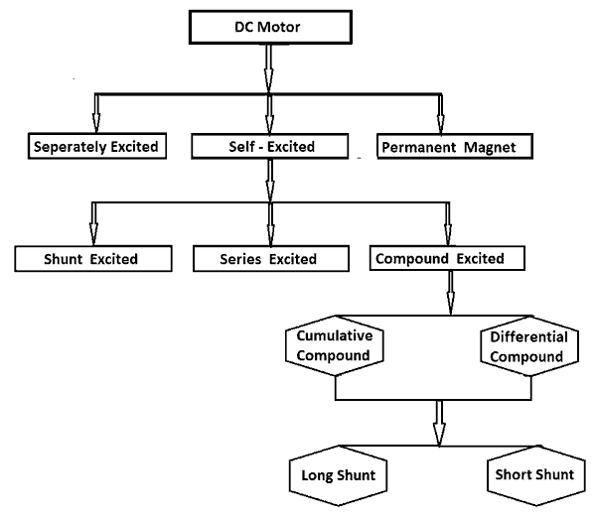
Types of DC Motors
Motors are also usually classified according to the way in which their fields are excited.

Slide 36
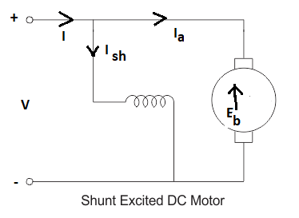
DC Shunt Motor
The field winding is connected in parallel with the armature winding so that the terminal voltage of the motor is applied across it.

Slide 37
The total current I =I_{sh} + I_{a}
Shunt field current is equal to
Armature current is equal to
The voltage across the armature (V)= E_{b} + I_{a}R_{a}
The power required to overcome the opposition is (P_{d})=E_{b}. I_{a}
Efficiency of the motor

Slide 38
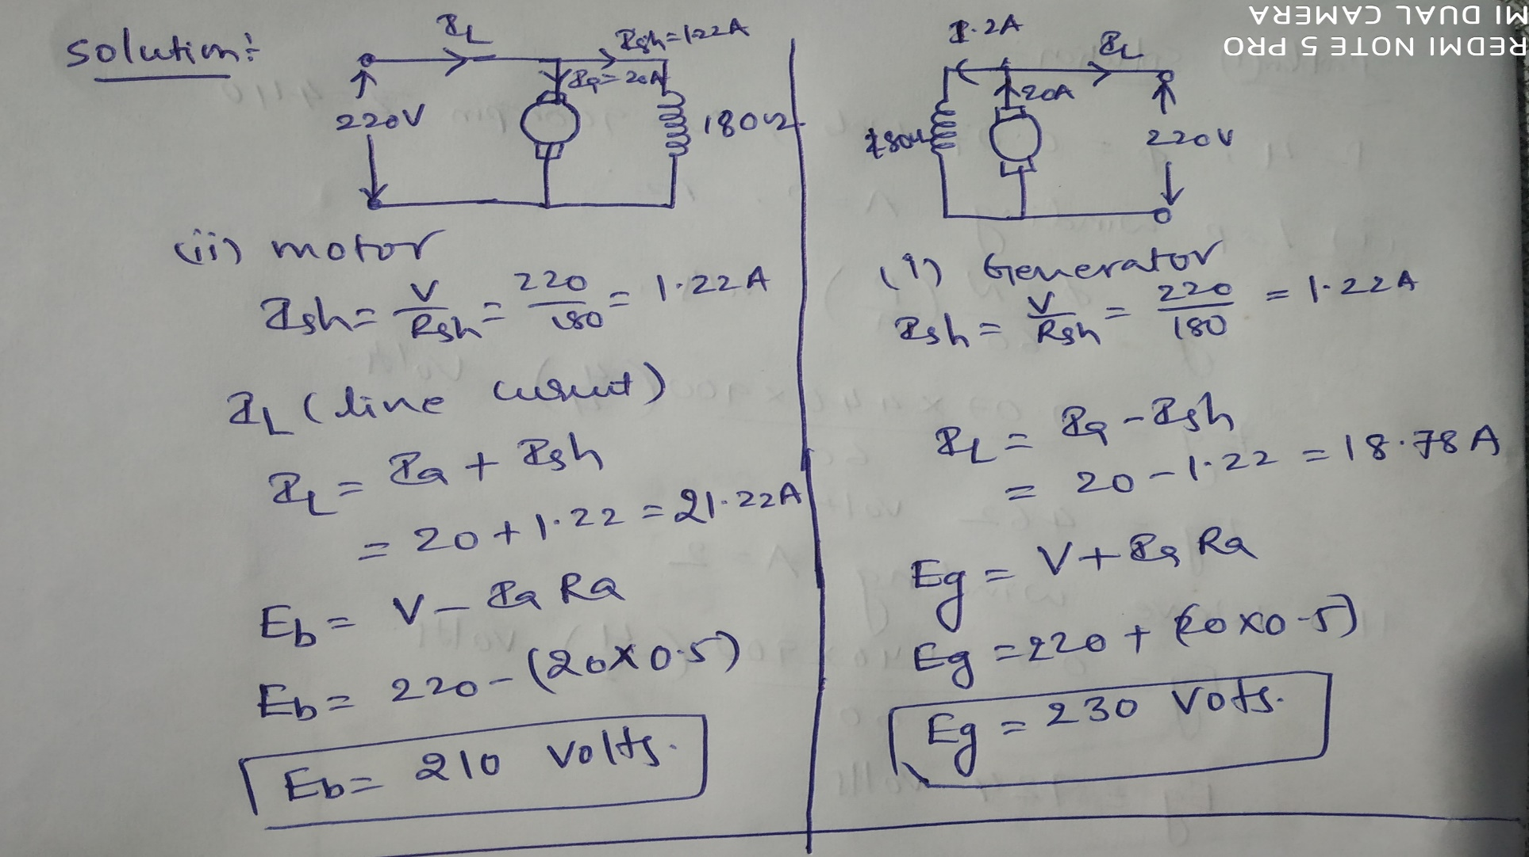
Problem 7: A 220V DC shunt machine has an armature and shunt filed resistance are 0.5 and 180 ohm respectively. If the full load armature current is 20A, find the induced emf and line currents when the machine act as (i) Generator (ii) Motor.

Slide 39
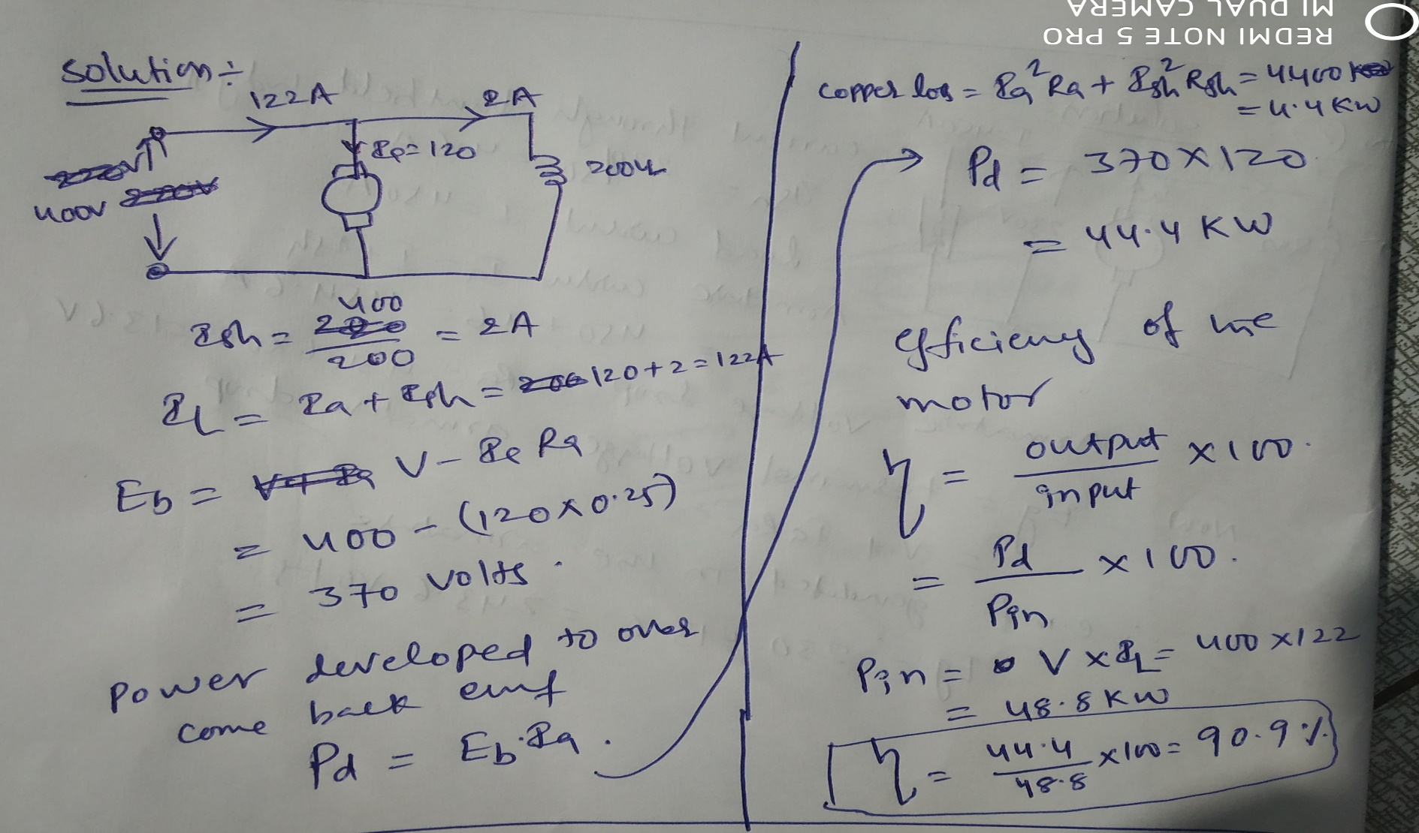
Problem 8: A dc shunt motor connected to 400V supply and takes an armature current of 120A at full load. If the armature and filed circuit have 0.25 and 200 ohm resistance respectively. Determine the back emf, field and line currents, power required to overcome back emf , copper loss and efficiency.

Slide 40
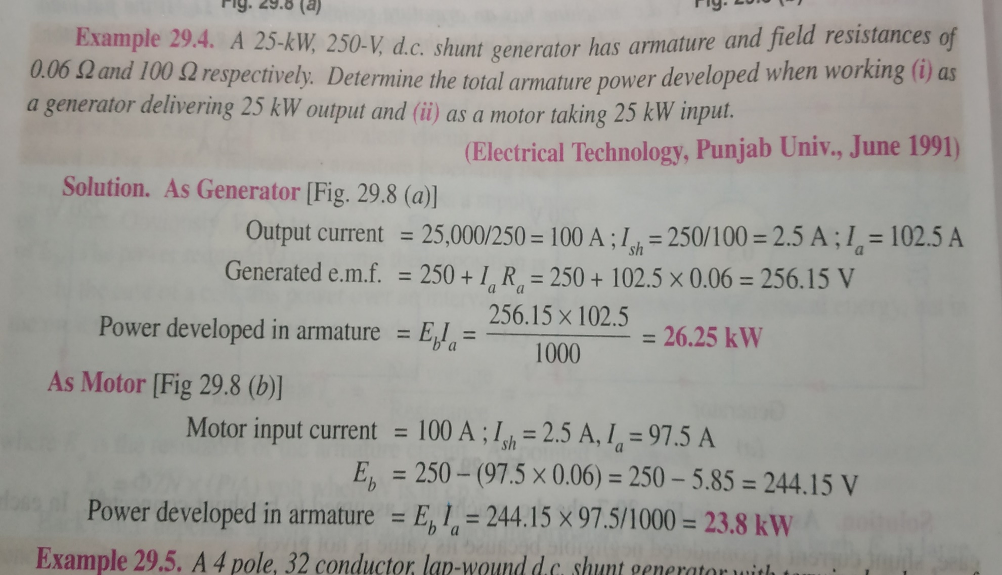

Slide 41
Torque in DC Motor:
Total electrical power supplied to the armature = Mechanical power developed by the armature + losses d ue to armature resistance. The mechanical power developed by the armature is Pm.
(1)
Also, the mechanical power rotating armature can be given regarding torque T and speed .
(2)
Where n is in revolution per seconds (rpm) and T is in Newton-Meter. Substitute equation (1) in equation(2) and get torque equation
(3)

Slide 42
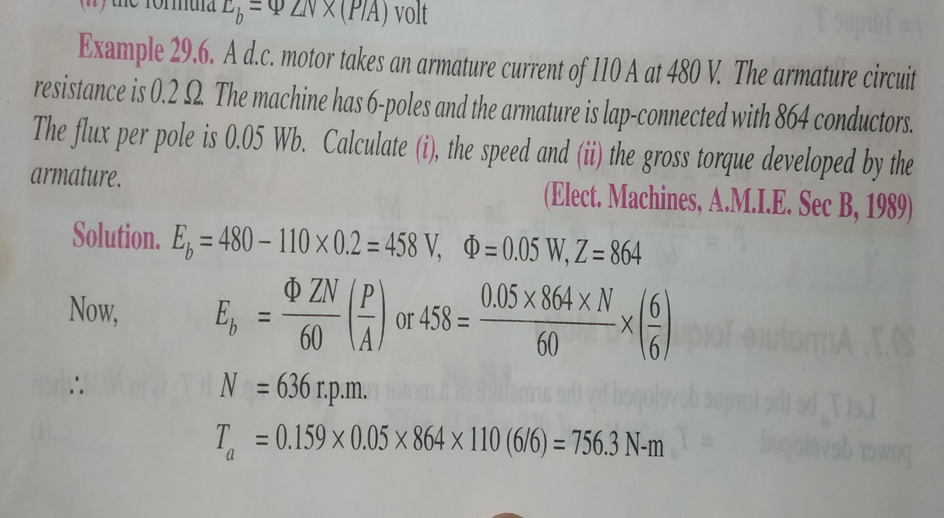

Slide 43
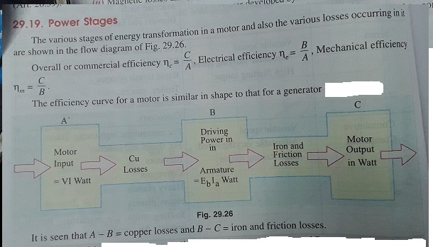
Power Stages in D.C Motor

Slide 44
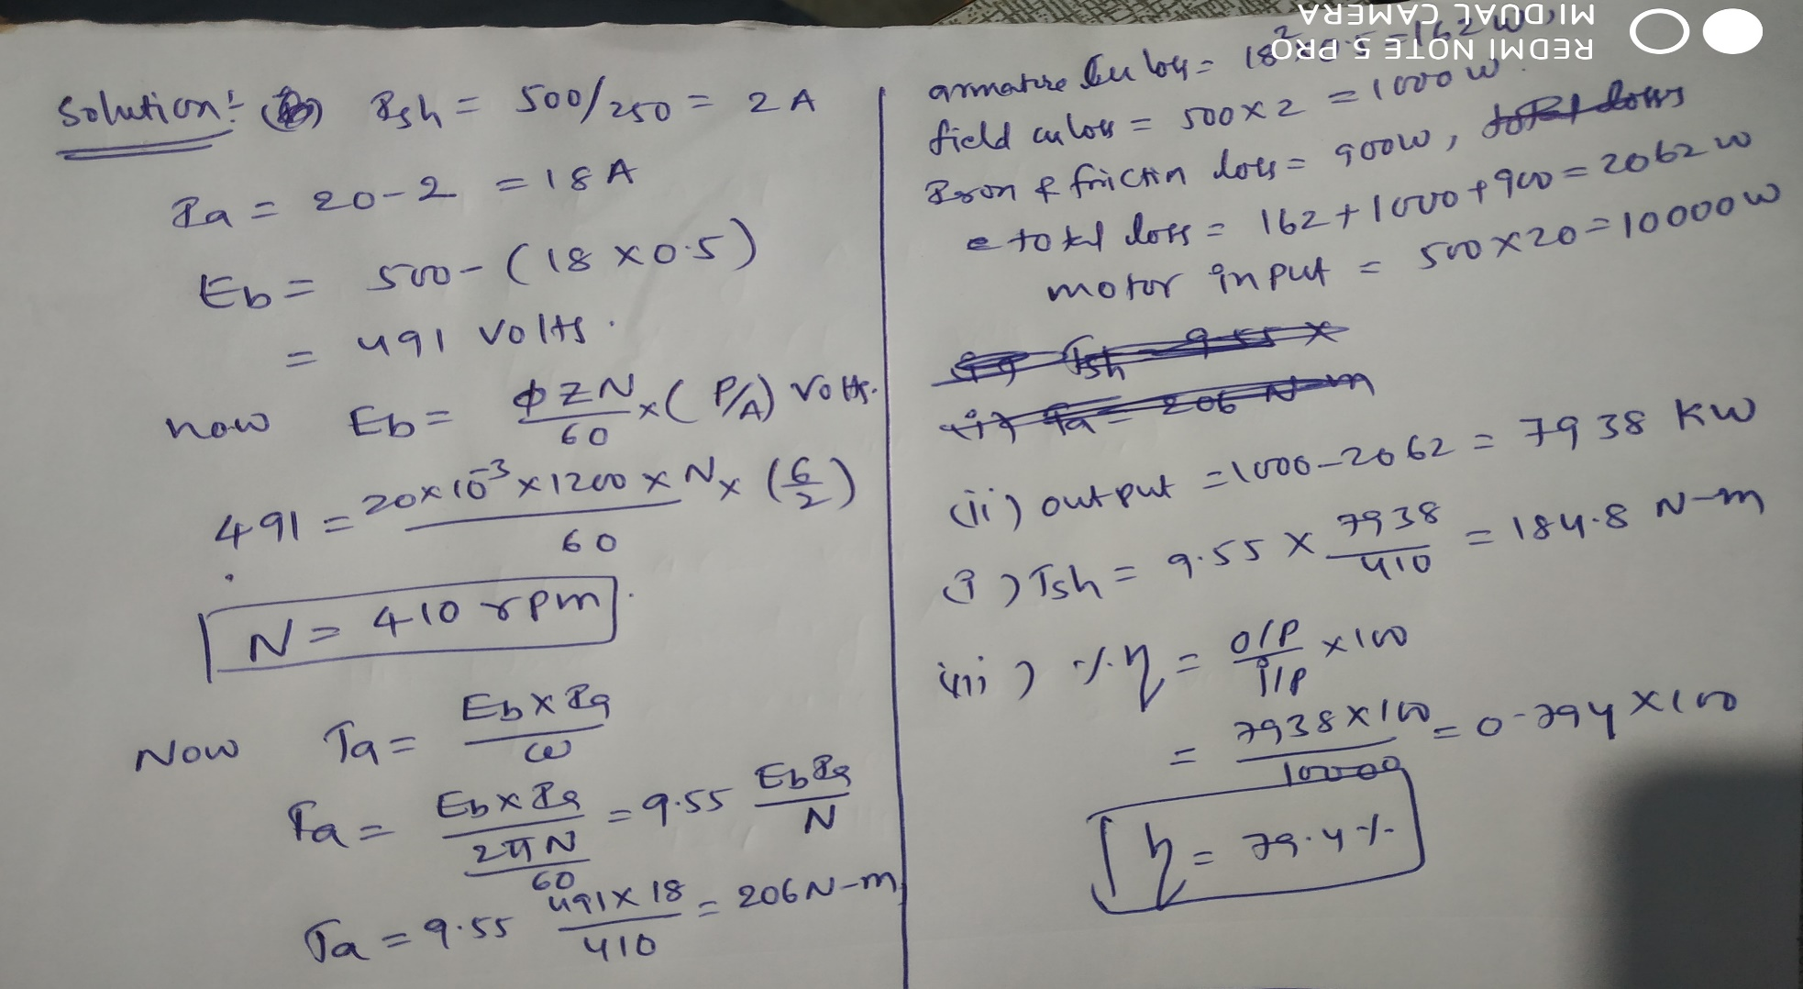
Problem 9: A 6 pole, 500 V wave connected shunt motor has 1200 armature conductors and useful flux/pole of 20 mWb. The armature and field resistance are 0.5 and 250 ohm respectively. What will be the speed and torque developed by the motor when it draws 20 A from the supply mains? Neglect the armature reaction. If magnetic and mechanical losses amount to 900W, find (i) useful toque (ii) output in KW and (iii) efficiency at this load.

Slide 45
THANK YOU

